Slide 1


Docker
Docker Image

Slide 2
Lesson Agenda
Learn about the structure of docker images
Dockerfile
Pushing the image to the repository

Slide 3
Introduction
A Docker image is a unit of packaging that contains everything required for an application to run. This includes; application code, application dependencies, and OS constructs. If you have an application’s Docker image, the only other thing you need to run that application is a computer running Docker.
You get Docker images by pulling them from an image registry
The pull operation downloads the image to your local Docker host where Docker can use it to start one or more containers.
Images are made up of multiple layers that are stacked on top of each other and represented as a single object. Inside of the image is a cut-down operating system (OS) and all of the files and dependencies required to run an application

Slide 4
Docker Images
Images are like stopped containers
images are considered build-time constructs, whereas containers are run-time constructs.
We use the docker container run and docker service create commands to start one or more containers from a single image. Once you’ve started a container from an image, the two constructs become dependent on each other and you cannot delete the image until the last container using it has been stopped and destroyed. Attempting to delete an image without stopping and destroying all containers using it will result in an error.
Image also don’t contain a kernel — all containers running on a Docker host share access to the host’s kernel.
Windows-based images tend to be a lot bigger than Linux-based images because of the way that the Windows OS works. It’s not uncommon for Windows images to be several gigabytes and take a long time to pull.

Slide 5
(Images)Why/What/How
For requirements which are specific to a project
For shipping the project to a different location
We can containerize any application.
Dockerfile is needed to build an image. It follows a INSTRUCTION argument format

Slide 6
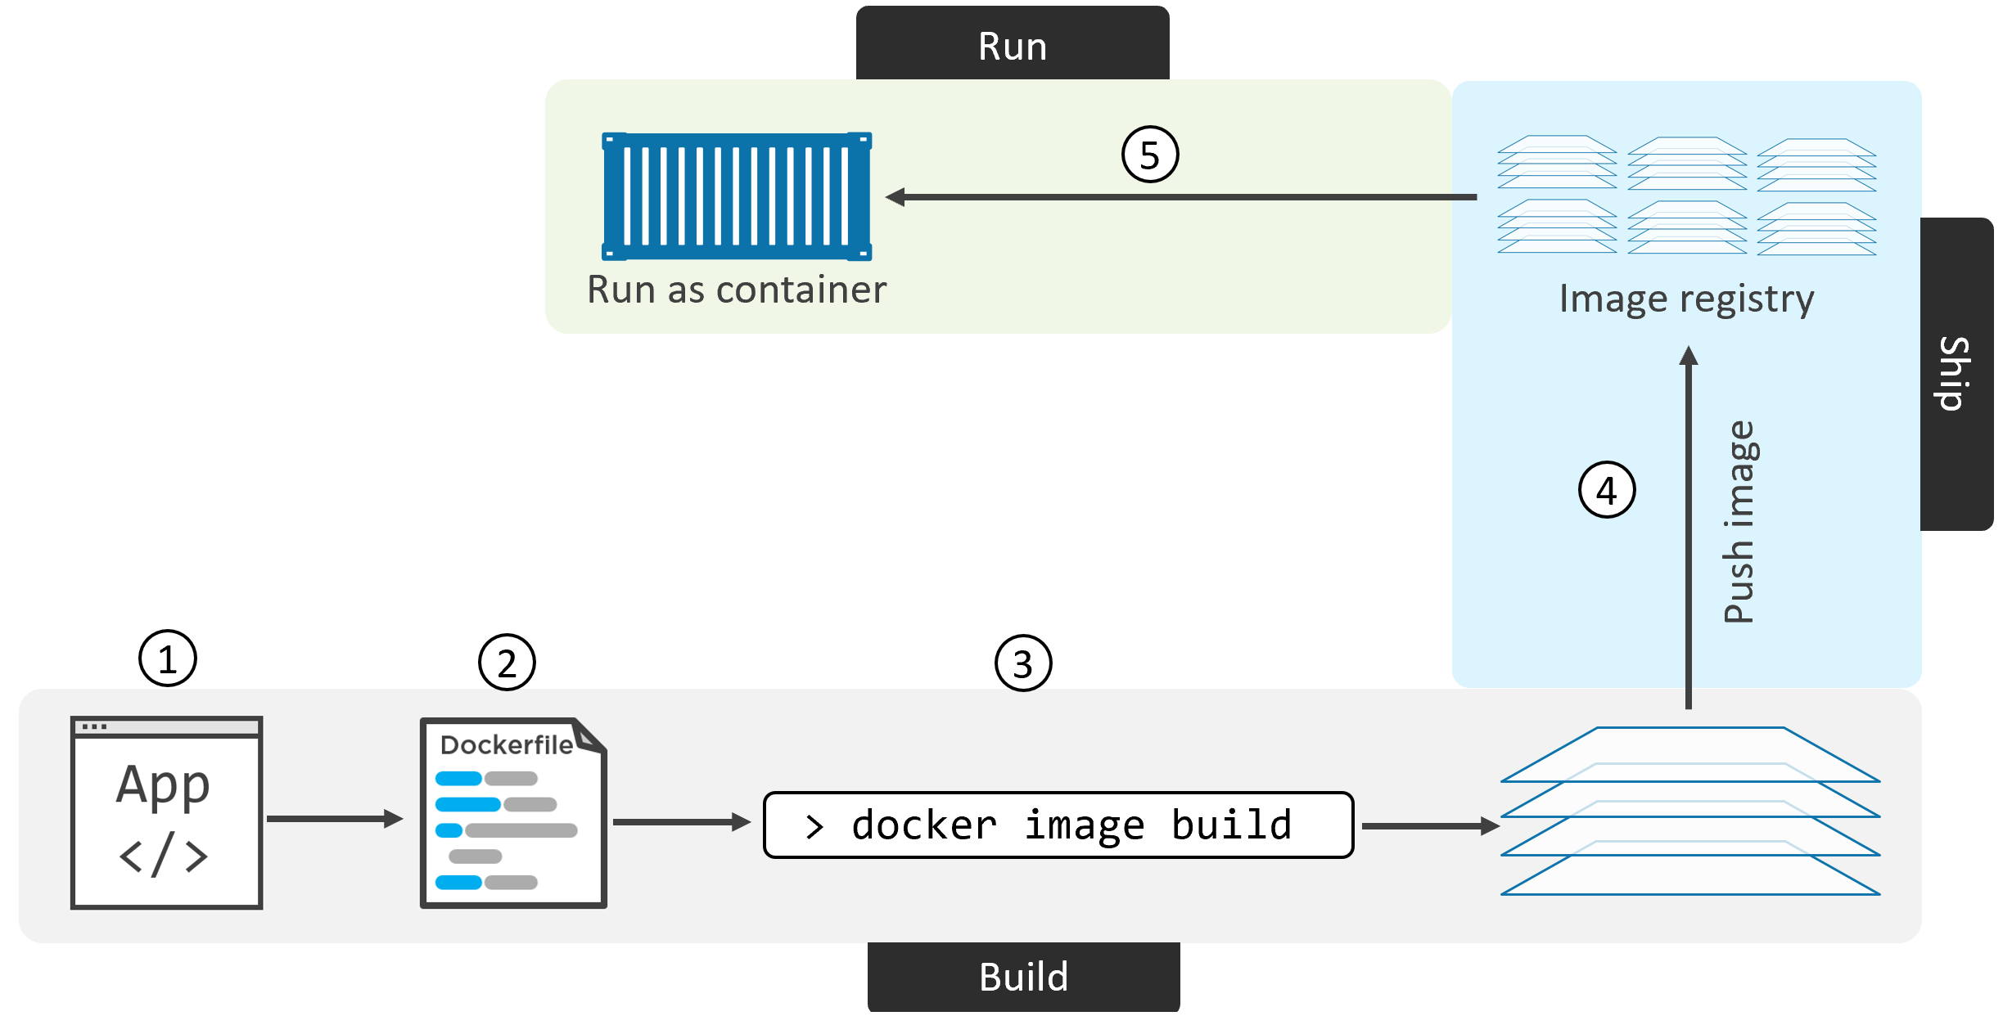

Slide 7
Image Pull
A cleanly installed Docker host has no images in its local repository.
The local image repository on a Linux-based Docker host is usually located at /var/lib/docker/<storage-driver>.
The process of getting images onto a Docker host is called pulling.
We store images in centralized places called image registries.

Slide 8
Official and unofficial repositories
Docker Hub has the concept of official repositories and unofficial repositories.
official repositories are the home to images that is vetted and curated by Docker, Inc. They contain up-to-date, high-quality code, that is secure, well-documented, and in-line with best practices.
With unofficial repositories we should not assume they are safe, well-documented or built according to best practices.
Most of the popular applications and base operating systems have their own official repositories on Docker Hub.
Pulling images from an unofficial repository is essentially the same — you just need to prepend the repository name with a Docker Hub username or organization name.

Slide 9
Image naming and tagging
Accessing images from official repositories is as simple as providing the repository name and tag separated by a colon (:)
$ docker image pull <repository>:<tag>
$ docker image pull alpine:latest
if you do not specify an image tag after the repository name, Docker will assume you are referring to the image tagged as latest. If the repository doesn’t have an image tagged as latest the command will fail.
Just because an image is tagged as latest does not guarantee it is the most recent image in a repository.
If you want to pull images from 3rd party registries (not Docker Hub), you need to prepend the repository name with the DNS name of the registry. For example, the following command pulls the 3.1.5 image from the google-containers/git-sync repo on the Google Container Registry (gcr.io).
$ docker image pull gcr.io/google-containers/git-sync:v3.1.5

Slide 10
Images with multiple tags
A single image can have as many tags as you want. This is because tags are arbitrary alpha-numeric values that are stored as metadata alongside the image.
Pull all of the images in a repository by adding the -a flag to the docker image pull command
$ docker image pull -a alpine
Docker provides the --filter flag to filter the list of images returned by docker image ls.
$ docker image ls --filter dangling=true
A dangling image is an image that is no longer tagged, and appears in listings as <none>:<none>
You can delete all dangling images on a system with the docker image prune command. If you add the -a flag, Docker will also remove all unused images

Slide 11
--filter
dangling: Accepts true or false, and returns only dangling images (true), or non-dangling images (false).
before: Requires an image name or ID as argument, and returns all images created before it.
since: Same as above, but returns images created after the specified image.
label: Filters images based on the presence of a label or label and value. The docker image ls command does not display labels in its output.

Slide 12
Searching docker hub from the CLI
$ docker search jkjha
The command above will search for all the images with ‘jkjha’ in its name
$ docker search alpine
command will list all repositories that include the string “alpine” in the name.

Slide 13
Images and layers
A Docker image is just a bunch of loosely-connected read-only layers, with each layer comprising one or more files.
Docker takes care of stacking these layers and representing them as a single unified object.
There are a few ways to see and inspect the layers that make up an image.
One way to see the layers of an image is to inspect the image with the docker image inspect command.
$ docker image inspect ubuntu:latest
Pull command also shows the image layers being pulled
Docker history is also a popular way but it is not reliable.
All Docker images start with a base layer, and as changes are made and new content is added, new layers are added on top.

Slide 14
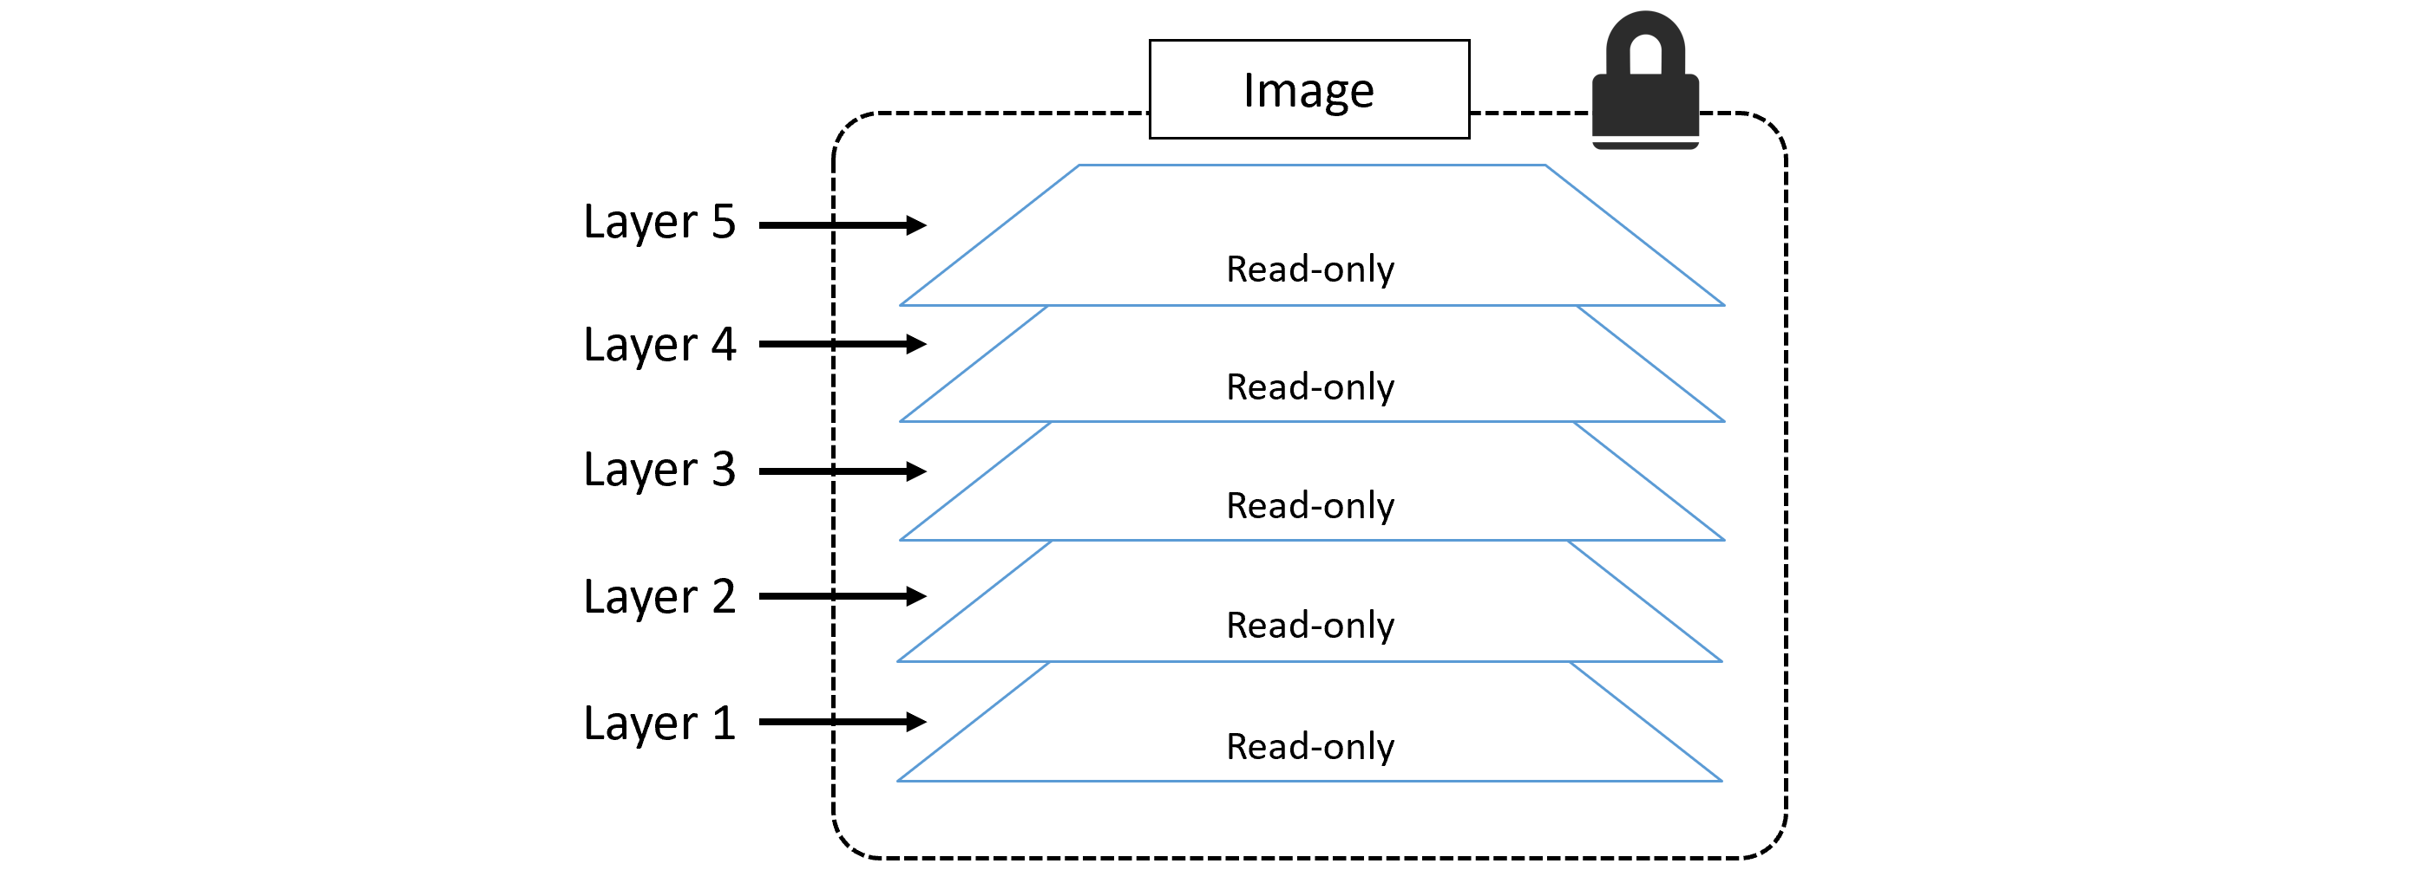

Slide 15
Pulling images by digest
As an example, imagine you’ve got an image called myImage:1.5 and it has a known bug. You pull the image, apply a fix, and push the updated image back to its repository using the same tag.
That image is being used by containers in your production environment. You create a new version of the image that includes a fix. Then comes the mistake… you build and push the fixed image back to its repository with the same tag as the vulnerable image!. This overwrites the original image and leaves you without a great way of knowing which of your production containers are using the vulnerable image and which are using the fixed image — they both have the same tag!
For the purposes of this discussion, we’ll refer to this hash as the digest. As the digest is a hash of the contents of the image, it’s impossible to change the contents of the image without creating a new unique digest. Put another way, you cannot change the content of an image and keep the old digest. This means digests are immutable and provide a solution to the problem we just talked about.
$ docker image ls --digests alpine

Slide 16
In some ways, the image itself is just a configuration file that lists the layers and some metadata.
The layers are where the data lives (files and code etc.). Each layer is fully independent, and has no concept of being part of an overall bigger image.
Each image is identified by a crypto ID that is a hash of the config file. Each layer is identified by a crypto ID that is a hash of the layer content. we call these “content hashes”.
This means that changing the contents of the image, or any of its layers, will cause the associated crypto hashes to change. As a result, images and layers are immutable, and we can easily identify any changes made to either.
When we push and pull images, we compress their layers to save network bandwidth as well as storage space in the image registry.
When you no longer need an image on your Docker host, you can delete it with the docker image rm command. rm is short for remove.

Slide 17
Demonstration
Let us now build a test image and publish it on the docker hub

